Slide 1
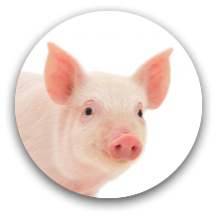
PIG: a Profile Interface Generator
LC Hackathon
July 12, 2013
Yanhua Sun, UIUC
Todd Gamblin, CASC

Slide 2
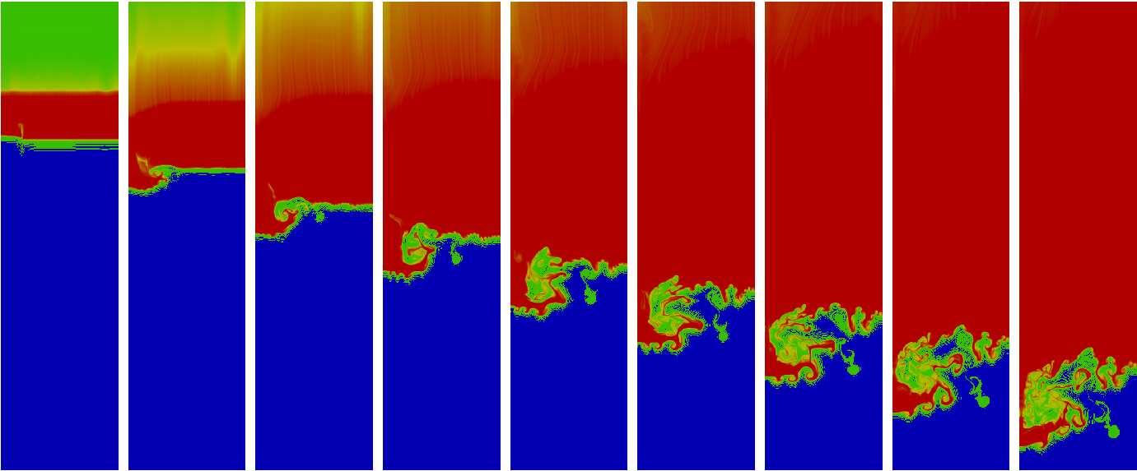
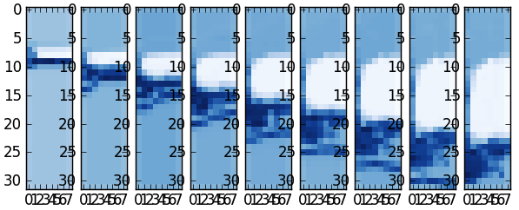
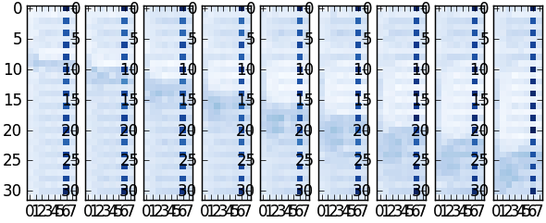
Problem: Tool developers want more information about applications!
Physics Data
Floating point ops
Cache misses
Plots show per-time step measurements from the Miranda multi-physics code
To measure per-time step, we need to know when a time step begins and end

Slide 3
How do I tell tools about my code?
for (i=0; i < nsteps; i++) {
do_radiation();
do_hydro()
}
4-line multi-physics code
Say I’m an application developer
Clearly, I want to instrument this code to use awesome performance tools!
How do I do that?

Slide 4
MPI provides a call that allows applications to talk to tools
int MPI_Pcontrol(int ctl, …);
MPI_Pcontrol is defined in the MPI library
does nothing by default
Designed to be intercepted by profiling tools
Tools use it to start and stop profiling
Applications can call Pcontrol without having to link to a new library

Slide 5
Instrumenting time steps
for (i=0; i < nsteps; i++) {
do_radiation();
do_hydro()
}
for (i=0; i < nsteps; i++) {
MPI_Pcontrol(0); // start time step
do_rad();
do_hydro()
MPI_Pcontrol(1); // end time step
}
That’s kind of ugly, but all right.
Now how do I add regions?

Slide 6
Instrumenting regions
for (i=0; i < nsteps; i++) {
do_radiation();
do_hydro()
}
for (i=0; i < nsteps; i++) {
MPI_Pcontrol(-1); // start time step
MPI_Pcontrol(1); // start radiation
do_rad();
MPI_Pcontrol(-2); // end radiation
MPI_Pcontrol(2); // start hydro
do_hydro()
MPI_Pcontrol(-2); // end hydro
MPI_Pcontrol(-1); // end time step
}

Slide 7
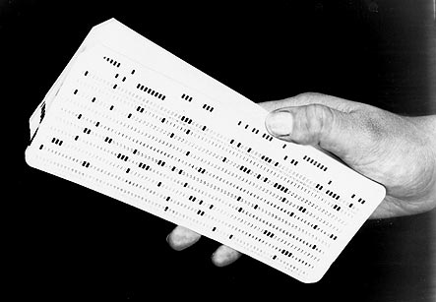
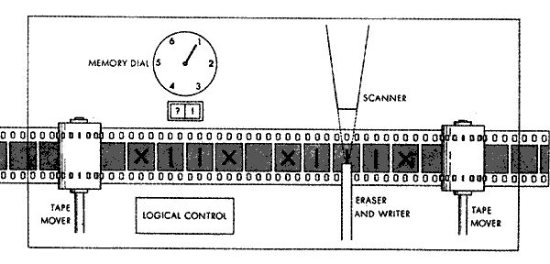
Interfaces that are potentially better than MPI_Pcontrol
Punch Cards
Turing Machine

Slide 8
PIG can help!
for (i=0; i < nsteps; i++) {
do_radiation();
do_hydro()
}
#include “phase_interface.h”
for (i=0; i < nsteps; i++) {
start_step();
start_phase(“radiation”);
do_radiation();
end_phase();
start_phase(“hydro”);
do_hydro()
end_phase();
end_step();
}
That’s better!

Slide 9
PIG generates interfaces
void start_step();
void end_step();
void start_phase (
const char* name);
void end_phase();
C Header
phase_interface.h
Application Interfaces
Tool Interface
C header
Fortran header
Unmarshalling code for Tools
Application headers contain only macros!
Macros call MPI_Pcontrol() with encoded arguments
No special library to link to!
Decodes arguments from MPI_Pcontrol()
Delegates to handler callbacks
Publish/subscribe interface

Slide 10
PIG Output
void startStep();
void endStep();
void start_phase(const char* name);
void end_phase();
#define PIG_PCONTROL_ID 3974
#define PIG_start_step_ID 0
#define PIG_end_step_ID 1
#define PIG_start_phase_ID 2
#define PIG_end_phase_ID 3
typedef struct
{
const char *name;
} start_phase_args_t;
#define start_step() \
do { \
MPI_Pcontrol(PIG_PCONTROL_ID, PIG_start_step_ID, NULL); \
} while (0)
#define end_step() \
do { \
MPI_Pcontrol(PIG_PCONTROL_ID, PIG_end_step_ID, NULL); \
} while (0)
#define start_phase(name) \
do { \
start_phase_args_t start_phase_args = {name}; \
MPI_Pcontrol(PIG_PCONTROL_ID, PIG_start_phase_ID, &start_phase_args); \
} while (0)
#define end_phase() \
do { \
MPI_Pcontrol(PIG_PCONTROL_ID, PIG_end_phase_ID, NULL); \
} while (0)
Yay!

Slide 11
PIG Implementation
Code generation in python
Used pycparser
Small tool library to do function dispatch
Allows registration of listener functions

