Slide 1
What’s Coming in MPI-3 RMA?
Major revision to RMA
Exciting new capabilities
Backward compatibility with MPI 2.2
Summarize the most significant changes:
New RMA operations
New synchronization operations
Coherent windows
Dynamic windows
Shared memory windows

Slide 2
New RMA Operations
MPI_Win_allocate
MPI allocates space for the window
Enables layout optimizations, intranode optimizations, …
Atomic Operations: CAS, Fetch-and-Op, and Get_Accumulate
Mutex space overhead MPI-3: O(1)
Can build lock-free structures
Accumulate operations can be ordered
Request-based non-blocking ops
More effective communication/computation overlap

Slide 3
New Synchronization Operations
Flush
Flush: Ensures remote completion of RMA operations
Flush_local: Ensures local completion of RMA operations
Enables RMW within an epoch
Sync
Synchronizes public/private memory, does not complete RMA ops
Effectively a local memory fence
Less expensive than lock/unlock
Test/Wait for request-based operations
Guarantees local completion of RMA operations
Separation of local and remote completion
Enables RMW within an epoch

Slide 4
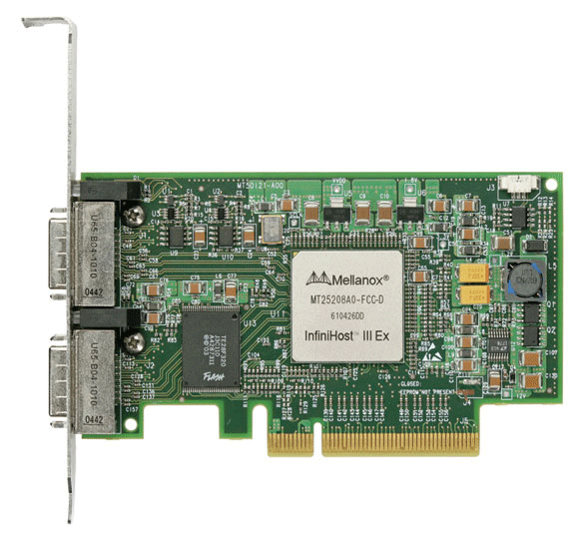
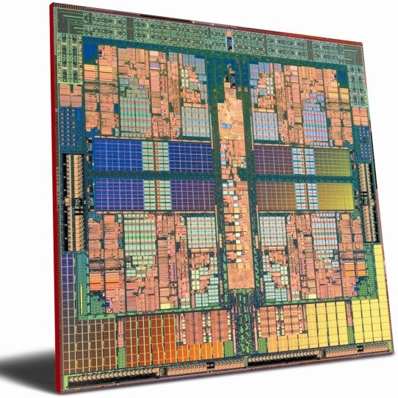
Coherent Windows
“Unified” memory model
Take advantage of coherent hardware
Relaxed synchronization will yield better performance
Optional memory model
Conflicting accesses
Localized to locations accessed
Relaxed to undefined
Load/store does not “corrupt”
“Separate” model still supported
User can query model used by a window
Public
Copy
Unified
Copy
Private
Copy

Slide 5
Dynamic Windows
Enables programmer to dynamically add/remove memory to window
Support dynamic, one-sided structures
MPI_Win_create_dynamic(…)
MPI_Win_attach(…)
MPI_Win_detach(…)
Displacements are MPI_Aint addresses from beginning of memory (MPI_BOTTOM)
Linked list example included in draft MPI 3.0 spec

Slide 6
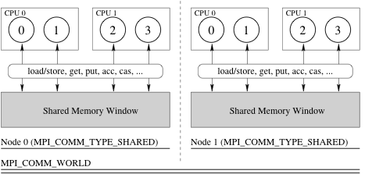
Shared Memory Windows
Incremental approach to MPI+Shared memory programming
Single parallel programming system, effective for intranode sharing
Preserves process model, less complex than, e.g. MPI+OpenMP
Three new routines:
MPI_Comm_split_type: Get a communicator for the node
MPI_Win_allocate_shared: Create/allocate a shared memory window
MPI_Win_shared_query: Get local pointers to window segments

