Slide 1
MPI I/O Proposals
The HDF Group
March 2013

Slide 2
Non Blocking Collective I/O
Comments we got after last vote and meeting:
Rushed proposal
Hard to implement in ROMIO
Is there real hardware support?
Suggest to modify ticket to:
Un-depricate the split collectives.
Just propose to add the 4 new routines.

Slide 3
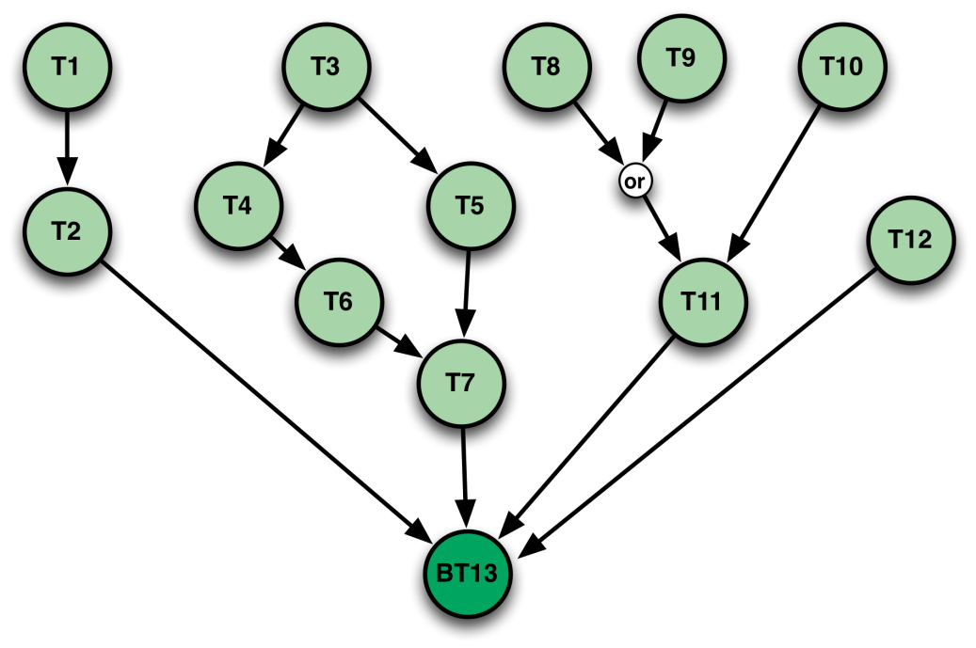
Asynchronous MPI I/O
Last discussion on Mailing list:
Can be easily built on top of MPI
Asynchronous Execution Engine (AXE):
Dependence flow graph with a thread pool
Insert operations with dependencies on parent operations that have to complete before they can start.
Any case for introducing such semantics into the standard?

Slide 4
Independent File View Changes (I)
All data access routines (independent and collective) have an MPI datatype and count to describe the data in memory.
Data description in file done through setting the MPI File View, which has to be called collectively.
Possible Solutions:
Update all data access operations to take a file datatype, offset and count.
Create a simpler MPI_File_set_view (next slide) that can be called independently but has some limitations.

Slide 5
Independent File View Changes (II)
int MPI_File_change_view(MPI_File fh, MPI_Offset disp, MPI_Datatype file_type, MPI_Info info);
Can’t change data representation:
Has to be done collectively.
Can’t use shared file pointer operations:
Shared file pointer is reset when the view is changed, so need to call the original set view before being able to using them.

Slide 6
Grouped I/O Access – Use case
Group 1
Group 2
0
1
2
3
4
5
6
7
1 Communicator that opened the file
Dataset 1
Dataset 2
1 HDF5 file, 2 or more datasets, each accessed by a subset of the processes that opened the file.

Slide 7
Grouped I/O Access - Proposal
We can either:
Add a new version for every MPI I/O data access routine for grouped I/O, which takes in addition to the file handle, an MPI_Group (or MPI_Comm?).
Add a new MPI_File_open_grouped routine that generates a new lightweight file handle from the original one, and changes collective access to be within the new group that is specified.
MPI_File_open_grouped(MPI_File fh, MPI_group grp, MPI_File *new_handle);

Slide 8
Extend Shared File Pointer Routines
For detailed use cases refer to EuroMPI’13 paper:
On the Usability of the MPI Shared File Pointer Routines
Shared file pointers could return more information to the user, specifically where the data access happened.
This combines the retrieval of the shared file pointer offset and access into an atomic operation that could is very useful.

Slide 9
New Interface for SFP Routines
int MPI_File_read_and_get_shared(MPI_File fh, void *buf, int count, MPI_Datatype datatype, MPI_Offset *position, MPI_Status *status);
int MPI_File_write_and_get_shared(MPI_File fh, void *buf, int count, MPI_Datatype datatype, MPI_Offset *position, MPI_Status *status);
int MPI_File_seek_and_get_shared(MPI_File mpi_fh, MPI_Offset offset, int whence, MPI_Offset *position)
Op_and_get() functions return old offset
Information that the MPI library already has (in most impl.)
Enables apps to know which locations they have accessed
Seek_and_get() allows a process to allocate space without immediately writing to it

