Slide 1
A Strawman for MPI Two-Sided Stream Triggering
Prof. Patrick G. Bridges
University of New Mexico
June 25, 2025

Slide 2
Step one: Current Proposals
Identified 9 different MPIX triggering proposals
  Both formal (e.g. papers) and informal (e.g. online)
  Some proposals included distinct triggering APIs that we studied as separate proposals
  Successive proposals around same interface were aggregated into a single proposal
  Don’t claim to have found them all
Step 1: Understand how to implement simple communication patterns in each of them
Step 2: Identify categories with similarities, differences, and recurring issues
Step 3: Classify proposals in categories
Note: Didn’t examine/compare with non-MPI triggered communication interfaces
List of implementations:
MPI-GDS: stream-triggered send/recv interface for MVAPICH
MCI-ACX Enqueued: stream-triggered portion of MPI-ACX
MPICH Triggering: stream-triggering interface for MPICH
HPE Send/Recv: stream-triggered send/recv interface for slingshot
Project Delorean: Graph-sequenced, stream-triggered MPI
HPE One-sided: stream-triggered PSCW interface for slingshot
Partitioned Communication: aggregation of MPI partitioned communication with Pbuf_prepare and partitioned collectives proposals; partially implemented by MPI-ACX
HPE Persistent: kernel-triggered interface for HPE slingshot
Intel GPU-Initiated: GPU-initiated interface for Intel MPI from Intel documentation and communications with Dan Holmes

Slide 3
Identified Categories
Area 1: GPU control path used: Stream or Kernel
Area 2: API Design Considerations
  Reuses Existing MPI APIs or abstractions: Yes or No
  Changes Existing MPI API Semantics:
  No, Strengthens, or Weakens
  Separate MPI Operation Initialization and Starting:
  Yes or No
  GPU MPI Operation Completion Support:
  All, Some, or None
  Collective Communication Support:
  Full, Partial, Group, or None
Area 3: Ordering and Concurrency Considerations
  MPI Operation Sequencing Abstraction: Yes or No
  Sequencing Abstraction Semantics: Full or Partial
  MPI Concurrency Standard Integration:
  Explicit, Implicit, or Unspecified
Area 4: Implementation Considerations
  GPU/NIC Progress: Yes or No
  Available Implementation or Evaluation: Yes or No
  Multi-architecture Support: Yes, GPU, NIC, or No
The full classification of 9 triggering proposals in these 12 categories is in our EuroMPI 2024 paper

Slide 4
Category Highlights
Area 1: GPU control path: Stream or Kernel
Area 2: API Design Considerations
  Reuses Existing MPI APIs or abstractions:
    HPE One-side, Partitioning, MPI-GDS: Yes
    HPE Two-sided, MPICH: No
  Separate Operation Initialization and Starting
    MPICH, MPI-GS, Intel: No
    Most others: Yes
  Note: Most stream-triggered APIs rely on +X fence on enqueued waits; legality of host wait on stream-triggered request often not clear
Area 3: Ordering and Concurrency Considerations
  MPI Operation Sequencing Abstraction
    HPE Two-sided, MPICH: Yes
    HPE One-sided, Most others: No
  MPI Concurrency Standard Integration:
  Only MPICH provides additional clarity
Area 4: Implementation Considerations
  GPU/NIC Progress: Yes or No
    HPE One-sided, Partitioning: Yes
    HPE Two-sided, most others: No
The full classification of 9 triggering proposals in these 12 categories is in our EuroMPI 2024 paper.

Slide 5
Key Gaps/Takeaways/Insights
Need to do something to prevent creating of dozens of new operations - persistence is promising but current semantics (both collective and p2p) are problematic
Need a consistent way to cause or assert that remote partners are ready for communication
APIs lack a clear concurrency model between triggered operations and host operations
Limited support for GPU-triggered MPI collective communication (traditional or neighbor)
Completion of kernel-triggered operations dependent on features of the programming environment

Slide 6
What did we learn?
Principles for designing an MPI+X GPU API
Focus on a two-sided stream triggering API that still allows one-sided data movement
Enqueuing starts and waits on operations is a natural API (e.g. MPI-ACX, MPICH, HPE Two-sided), and also potential provides a starting place for reasoning about progress and concurrency
Specify the operations to enqueue by building on/fixing persistence whenever possible
Leverage existing ideas for one-sided data movement of two-sided operations (e.g. MPI_RSend_init or an appropriate Info argument)
Include neighbor collectives from the beginning to enable aggregation of trigger/synch overheads
Leverage MPI Info arguments to provide hints about memory semantics
Define in tandem with development of C++ abstractions, benchmarks, and proxies for real hardware

Slide 7
Things we decided not to do
Communicators with changed semantics (MPI-GDS, MPIX_STREAM prototype, others)
  Breaks libraries those communicators are passed to
  Overloads communicators even further
Prepare considered harmful
  Requires host operation to ensure readiness on each iteration
  Prevents programmer from guaranteeing readiness through other means
  Prevents taking advantage of NICs that can rendezvous

Slide 8
Strawman (1): An MPI Queue Abstraction
Abstraction to tie the starting/waiting of multiple operations in a progress engine with execution on a core/accelerator/etc
  Pairing between an execution context and a progress engine context
  Define concurrency semantics similar to MPIX_Stream
  MPI_Enqueue_startall(queue, len, reqs)
  MPI_Enqueue_waitall(queue), MPI_Enqueue_wait(queue, req)
  MPI_Queue_wait(queue) – portably fence an MPI stream from the host
  Specific semantics of CUDA/MPI queue, Pthread/MPI queue in side documents
Example semantics questions
  Should we allow enqueue wait or just waitall? Need wait for reasons show later
  Can you enqueue a wait to a queue for a request started on another queue?
  Are operations on the same communicator on different queues logically concurrent?

Slide 9
Strawman (2): Fix Persistence Semantics
Goal: Enqueue persistent requests to queue
  Problem: Want to know exact remote buffer to put data into (p2p)
  Problem: Need to know that persistent request is fully initialized (collective)
Solution: Provide MPI_Match to lock persistent request semantics
  New request has a fixed destination buffer/communication partner
  Once per initialization, meant for host-based operation
  MPI_Match(req), MPI_Matchall(len, reqs)
  MPI_Imatch(req, &matchreq)
Example semantics questions
  Should this change the semantics of existing requests or make a new request?
  Should there be a persistent version of this that can also be enqueued?
  Is this new semantics about requests, e.g. do we need MPI_Ismatched(req)

Slide 10
Strawman (3): One-sided data movement and MPI_Info
Use ready send or MPI info equivalent to enable pure one-sided data movement.
  Requires eager send or stream-triggered rendezvous
  Keep flexibility to enable different hardware rendezvous approaches
  Programmer can use barrier or ssend to guarantee ready semantics.
Expand MPI Info arguments to provide consistency information about buffers (e.g. write through GPU memory on MI250X)

Slide 11
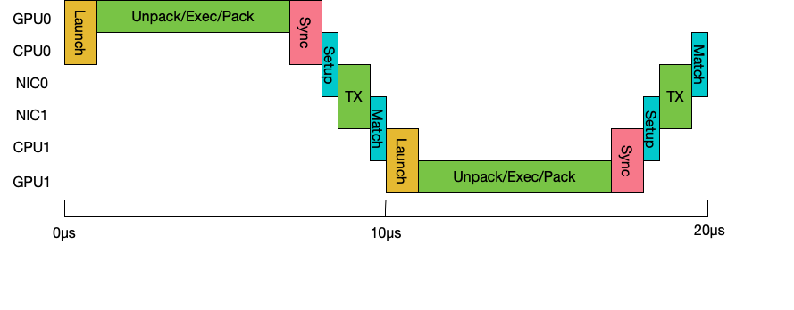
Implementation challenges influence API designs: Understanding a GPU ping pong
A traditional two-sided ping pong with GPU execution and message pack/unpack

Slide 12
A simple two-sided GPU ping pong has significant overheads: 20µs
Messaging Overheads
GPU overheads
A traditional two-sided ping pong with GPU execution and message pack/unpack
Everything in green is strictly necessary, everything else is overhead

Slide 13
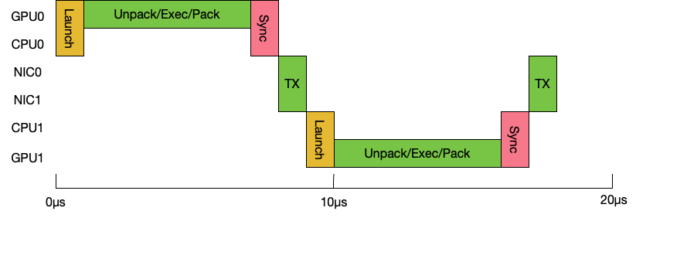
Real Persistent Two-sided or Clever One-sided can amortize away message overheads: 18µs
Traditional MPI persistent and traditional MPI one-sided get halfway there (19ms)
Need the right abstractions to even do this, though we know how to.

Slide 14
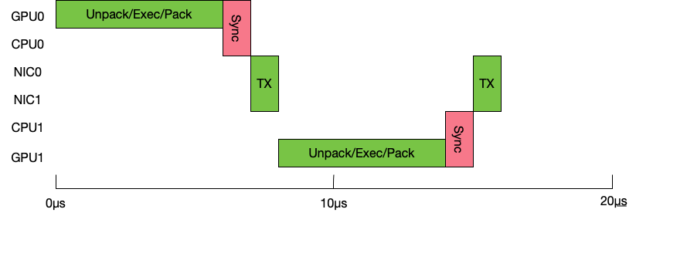
Stream Triggering wants to get rid of kernel launch overheads: 16µs
A stream-triggered communication
What happens if we send to multiple destinations? Lots of unnecessary memory barriers!
Really important for API to avoid unnecessary or amortize memory barriers!

Slide 15
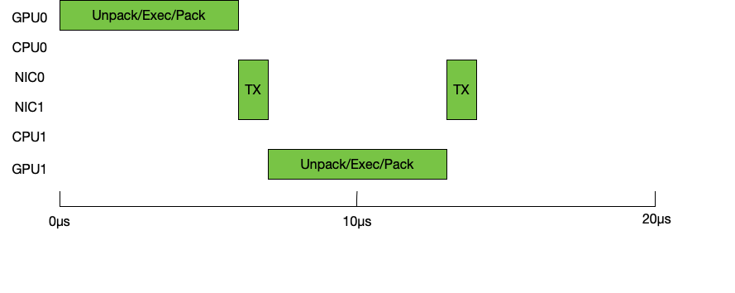
If we could somehow get rid of the GPU cache to NIC memory barriers: 14µs
This would be a total 25-30% performance improvement
Requires APIs that exposes memory semantics to the communication system

Slide 16
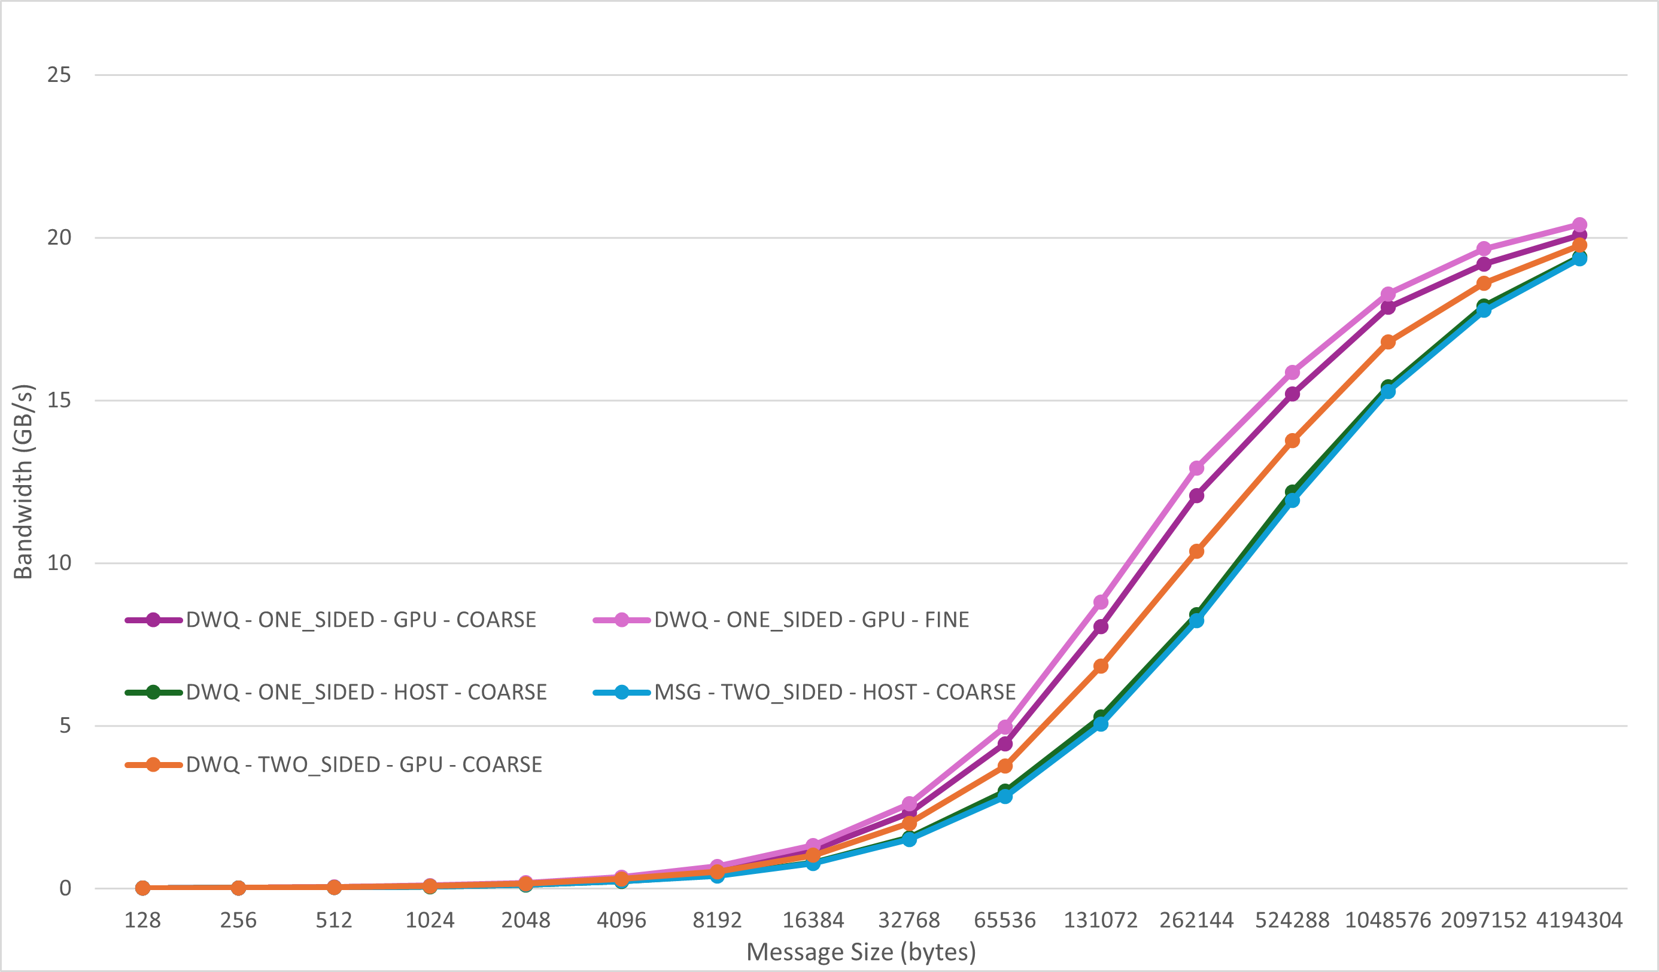
This bears out on AMD MI250X/Slingshot 11
Benchmark
  Packing GPU ping-pong
  Direct on libfabrics CXI
Get rid of sync by packing to MI250X cache coherent (write-through) memory
512KB ping-pong bandwidth increases by 33%
Even bigger gains for smaller messages (100% at 64KB)

Slide 17
Stream Triggered MPI Ping Pong - Setup
// Make MPI_Info for memory
MPI_Info mem_info;
MPI_Info_create(&mem_info);
MPI_Info_set(mem_info, "MPIX_MEM_TYPE", ”HIP_CC");
// Make queue and associate with HIP stream
MPIX_Queue my_queue;
MPIX_Queue_init(&my_queue, MPIX_QUEUE_TYPE_HIP,
&stream);
// Make standard requests and queue requests
#define SEND_REQ (rank ^ 1)
#define RECV_REQ (rank & 1)
#define BARRIER_REQ (2)
MPIX_Request tmp_reqs[3], queue_reqs[3];
// Create the unmatched persistent requests
MPIX_Recv_init(recv_buffer, num_items, MPI_INT,
rank, 0, MPI_COMM_WORLD, mem_info,
&tmp_reqs[RECV_REQ]);
MPIX_Rsend_init(send_buffer, num_items, MPI_INT,
rank ^ 1, 0, MPI_COMM_WORLD, mem_info,
&tmp_reqs[SEND_REQ]);
MPIX_Barrier_init(MPI_COMM_WORLD, MPI_INFO_NULL,
&tmp_reqs[BARRIER_REQ]
// Create matched requests for enqueuing
MPIX_Matchall(3, tmp_reqs, queue_reqs);

Slide 18
Stream Triggered MPI Ping Pong - Ping
// Make sure the receive on rank 1 is already started so we can use ready sends
if (rank) MPIX_Enqueue_start(my_queue, queue_reqs[RECV_REQ]);
MPIX_Enqueue_start(queue, queue_reqs[BARRIER_REQ]);
// The barrier completes before the previously enqueued receive!
MPIX_Enqueue_wait(queue, queue_reqs[BARRIER_REQ]);
for (int i = 0; i < num_iters; ++i) {
if (0 == rank % 2) { // Ping Side
compute_buffer<<<NUM_BLOCKS, BLOCK_SIZE, 0, stream>>>(
(int*)send_buffer, (int *)recv_buffer, n_items);
// Enqueue rsend ping and receive pong
MPIX_Enqueue_startall(my_queue, 2, queue_reqs, MPI_STATUS_IGNORE);
MPIX_Enqueue_waitall(my_queue); // wait for pong
}

Slide 19
Stream Triggered MPI Ping Pong - Pong
else { // Pong side
MPIX_Enqueue_waitall(my_queue); // Enqueue wait for ping
compute_buffer<<<NUM_BLOCKS, BLOCK_SIZE, 0, stream>>>(
(int*)send_buffer, (int*)recv_buffer, n_items);
if (i + 1 < num_iters)
// Enqueue start rx *next* ping AND tx of current pong
MPIX_Enqueue_startall(my_queue, 2, queue_reqs, MPI_STATUS_IGNORE);
} else { // Final Pong
MPIX_Enqueue_start(my_queue, queue_reqs[SEND_REQ], MPI_STATUS_IGNORE);
MPIX_Enqueue_waitall(my_queue);
}
}
}

Slide 20
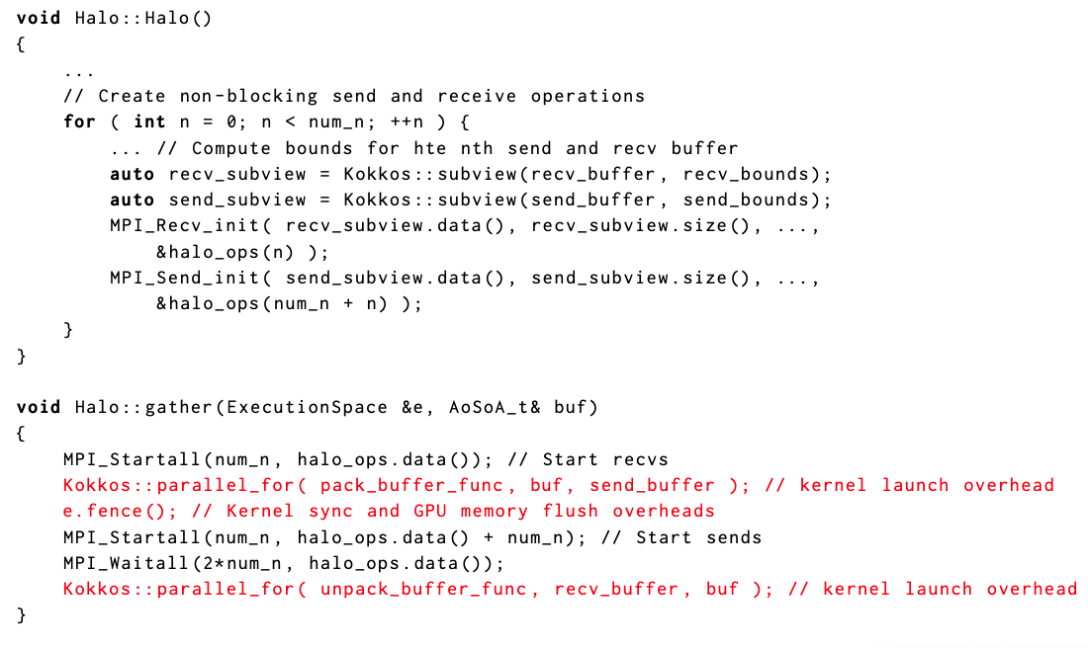
Original Code: Cabana Persistent Irregular Halo Exchange

Slide 21
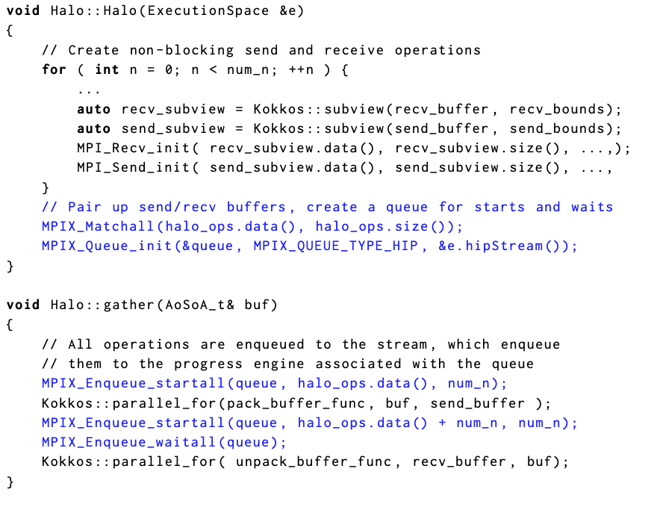
First Cut at Stream Triggering
Startall lets us tie all sends to a single triggering counter, but must be setup when startall is called.
Still requires implicit rendezvous to ensure readiness of destination buffer

Slide 22
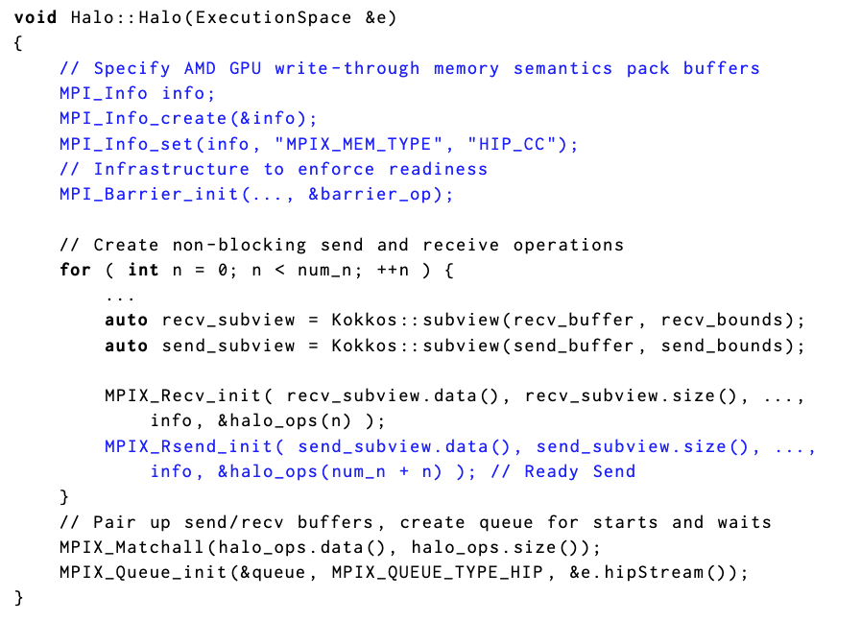
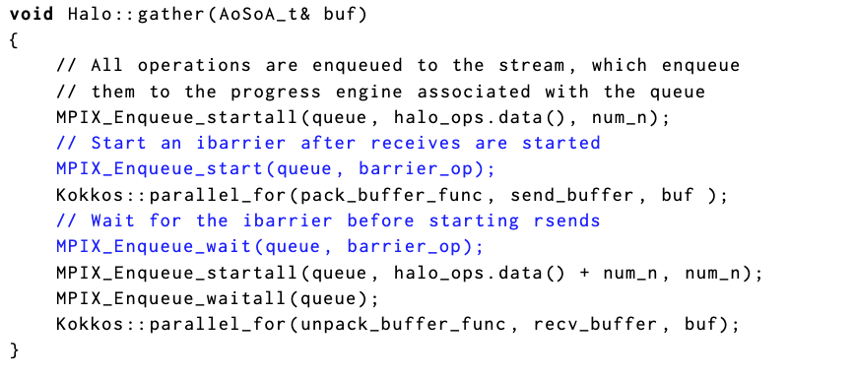
Full P2P Version
Persistent neighbor collectives would allow setting up shared triggering counter at creation
Would need a way to indicate readiness.
Readiness assertion info argument would be useful here, too.

Slide 23
Current Prototype Status
Implementing as an MPI Advance extension
  Correctness version: Basic semantics in CUDA/HIP version using stream operations/polls and a host communication thread
  Slingshot 11 using Libfabric CXI Counters to directly tie NICs and GPUs
    LLNL Tioga AMD MI250X + Slingshot 11
    LLNL Tuolumne AMD MI300A + Slingshot 11
    LANL Chicoma NVIDIA A100 + Slingshot 11
Have working prototypes of both with C++ benchmarks for testing
  Currently only point to point
  Starting performance optimization (sharing counters on startall, etc.)
  Lots of pieces we can build on for collectives (libnbc, schedules, continuations)
Later: Infiniband NICs (NVIDIA, Cornelis), Intel accelerators, etc.

Slide 24
Still lots of details to work out
What precisely should be the concurrency semantics of MPI queues
Are MPI queues a more general interface to progress engines (similar to some things that MPICH has examined)
How does this relate to stream-triggered one-sided (either HPE or what the one-side WG is looking at)? MPI_Match basically creates an underlying RMA window….

Slide 25
Thanks and Questions?
Collaborators: Tony Skjellum, Puri Bangalore, Amanda Bienz, Derek Schafer, Matthew Dosanjh, Hui Zhou, Jack Lange, Trey White, many others
Funding: NNSA PSAAP III Program
Email: patrickb@unm.edu

